Slide 1

Keyper
Keep your keys safe
מסמך ארכיטקטורה
נוי זוזל- ת.ז 311145270

Slide 2

Use Case Model
יצירת כספת
יצירת מפתח
מחיקת מפתח
חיפוש בכספת
שחזור מפתח
צפייה בכספת
סנכרון כספות
העתקת מפתח

Slide 3
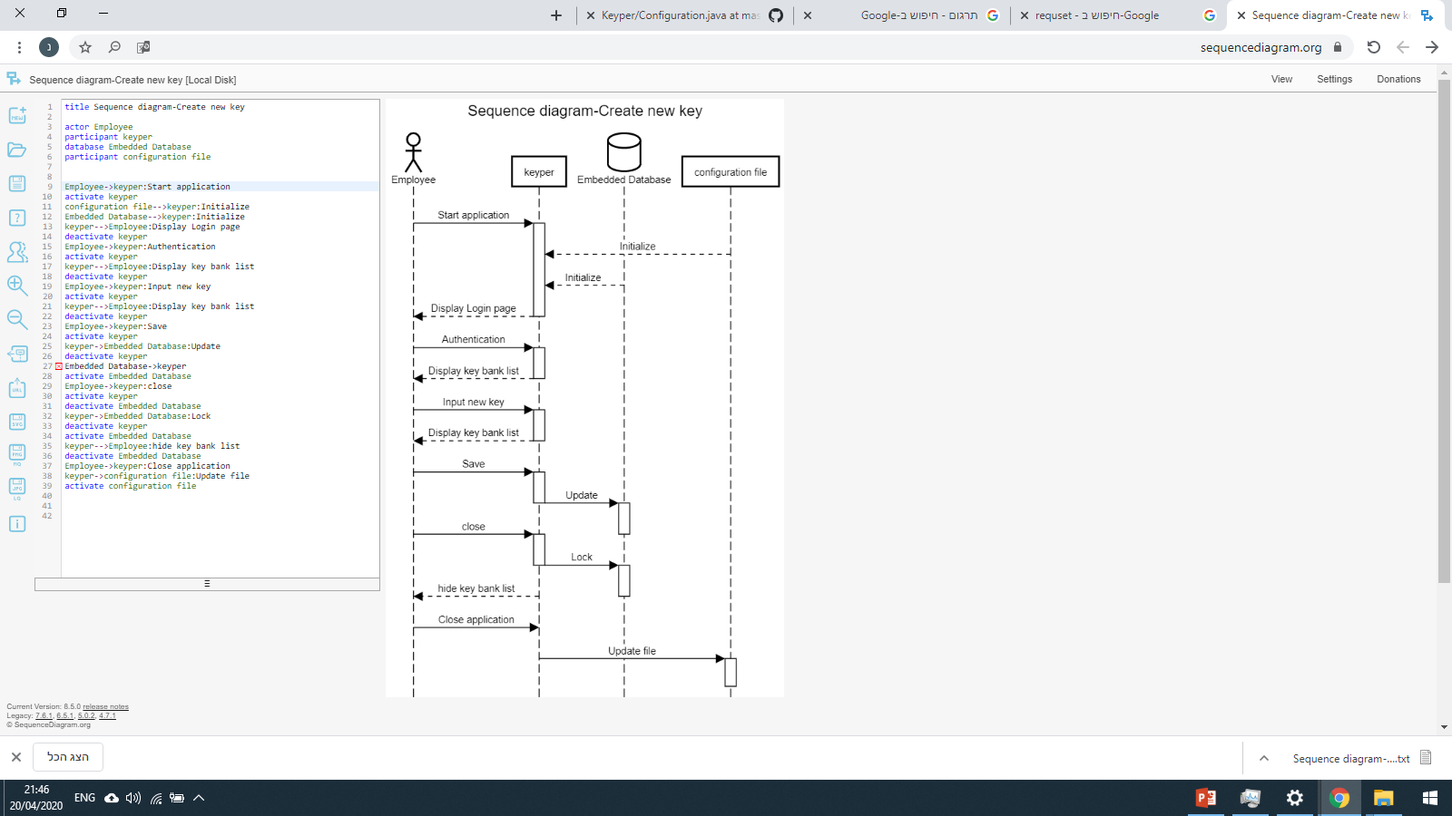
Read SD from top to bottom

Slide 4
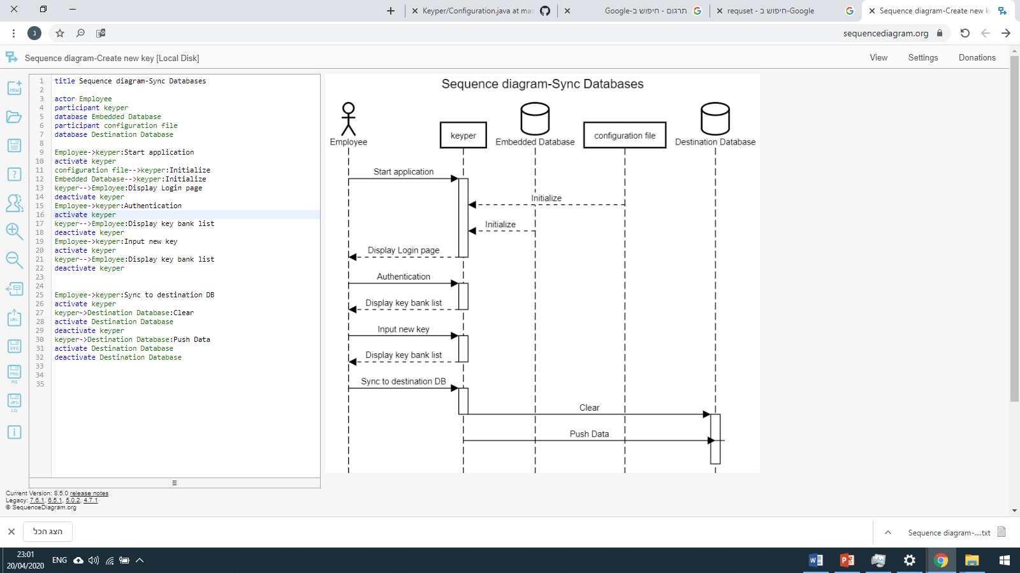
Read SD from top to bottom

Slide 5
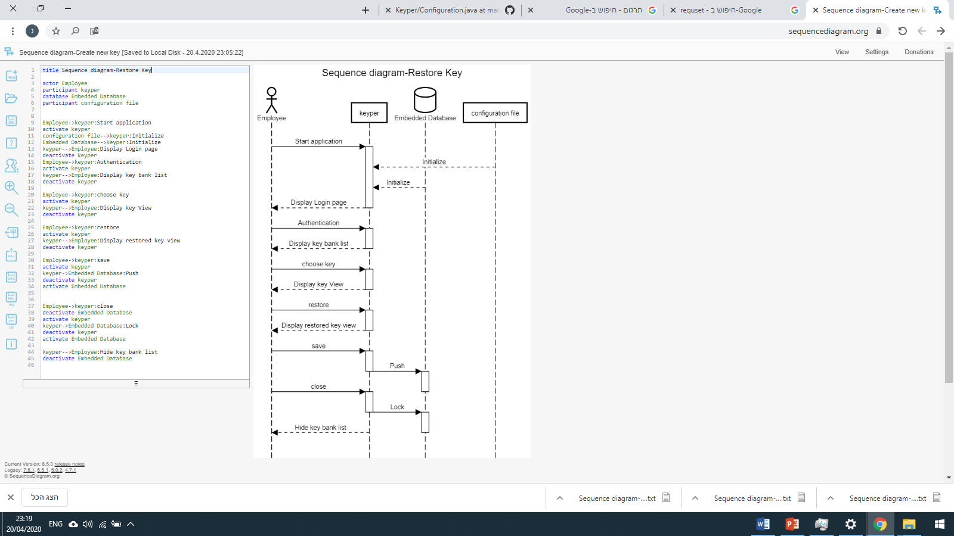
Read SD from top to bottom

Slide 6
Class Diagram

Slide 7
Configuration
Configuration(MasterPassword)
createFiles(MasterPassword)
getmClipBoardSleepTime()
getmKeyFile()
getmLastConnectionStat()
getmLastDbPath()
getmLockAfterTime()
getmPassword()
getmPrivatekey()
getmSid()
getmXmlFile()
importFiles()
setmClipBoardSleepTime(int)
setmKeyFile(String)
setmLastConnectionStat(int)
setmLastDbPath(String)
setmLockAfterTime(int)
setmPassword(String)
setmPrivatekey(String)
setmSid(String)
setmXmlFile(File)
Authentication
Database
getFileChecksum(File)
comparefiles(File, String)
comparepasswords(String, String)
comparesids(String)
Database(MasterPassword)
close(Bank)
connect()
create()
createtables()
pull(Bank)
push(Bank)
Bank
Bank()
addkey(Key)
getBank()
isexist(Key)
removekey(Key)
search(Bank)
Encryption
setKey()
Encryption()
createPrivateKey()
decrypt(String)
encrypt(String)
getMyKey()
setMyKey(String)
Generator
Generator()
generate(int, boolean, boolean, boolean, boolean)

Slide 8
Key
Key(String, String, String, String, String)
copypassword()
copyusername()
deletehistorykey(Date)
generatePassword(int, boolean, boolean, boolean, boolean)
gethistory()
gethistorydates()
getmAutocleartime()
getmExpired()
getmGroup()
getmHistory()
getmId()
getmPassword()
getmQuality()
getmTitle()
getmUrl()
getmUsername()
printhistory()
restore(Date)
setmExpired(Date)
setmGroup(String)
setmHistory(Map<Date, Key>)
setmId(String)
setmPassword(String)
setmQuality(int)
setmTitle(String)
setmUrl(String)
setmUsername(String)
viewhistorykey(Date)
System ClipBoard
clear()
copy(String)

Slide 9
MasterPassword
MasterPassword()
create(String, String, String, String)
getKeyfile()
getmBank()
getmConf()
getmDatabase()
getMkeyfile()
getMpassword()
getMsid()
getPassword()
getPath()
getSid()
getUsername()
importConfiguration()
setKeyfile(String)
setMkeyfile(String)
setMpassword(String)
setMsid(String)
setPassword(String)
setPath(String)
setSid(String)
setUsername(String)
signin(File, String, boolean, boolean, boolean)

Slide 10
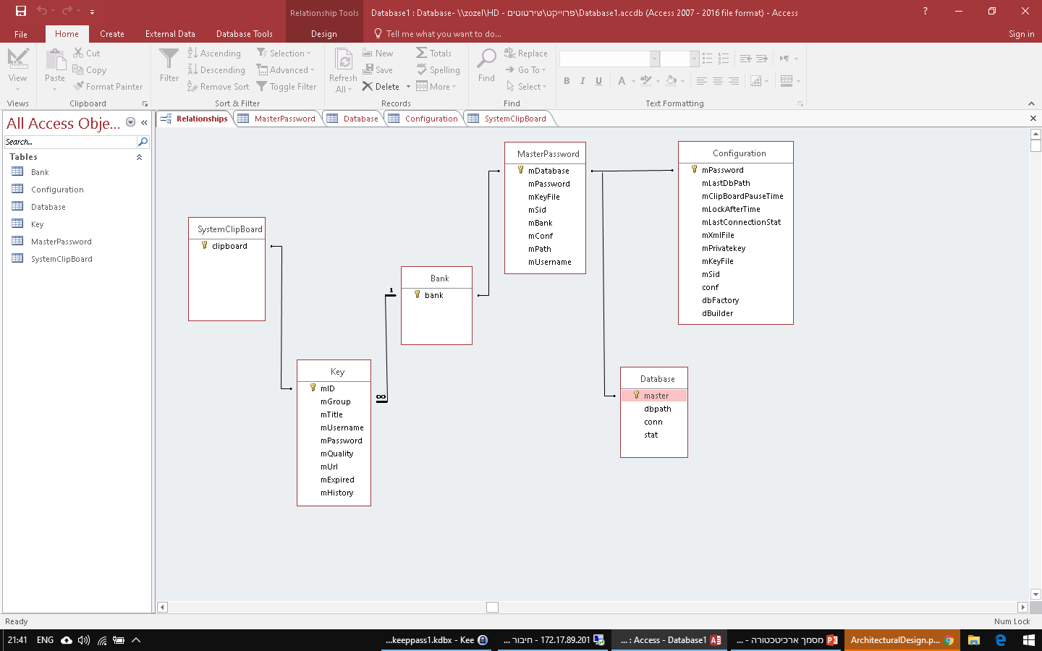
Connections Diagram
1
1
1
1
1
1
1

Slide 11
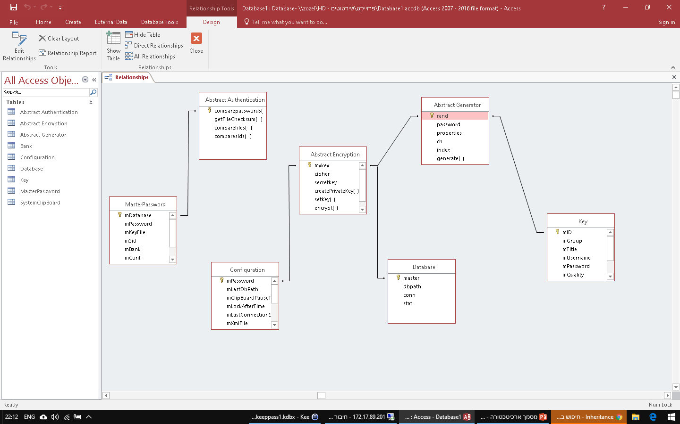
Inheritance Diagram

Slide 12
Mvc Model
controller
Update Database
Display objects from Database
Generate Password
Authentication
File hash algorithm
Transfer database /memory
Clipboard functions
Encryption/Decryption
model
view
Update memory
User actions
Database
Form Management
Display Objects From memory
Xml file
User Swing Interface
Display log Massages

